Slide 1
HOTEL REVIEW ANALYSIS
MDA 720

Slide 2
INTRODUCTION
The hospitality industry is highly competitive, and customers are looking for quality and personalized services when choosing their accommodations.
In this context, hotel reviews and online feedback play a crucial role in shaping the perception of potential customers.
Sentiment analysis is a technique that can be used to analyze large volumes of hotel reviews, classify them into positive, negative, or neutral categories, and identify the areas where the hotel can improve to enhance customer satisfaction.

Slide 3
Objective/Goals of the Project:
The goals of this project are:
To collect a large dataset of hotel reviews from online platforms.
To perform sentiment analysis on the reviews and classify them into positive, negative, or neutral categories.
To identify the areas where the hotel can improve to enhance customer satisfaction.
To provide recommendations for a new hotel business based on the analysis.

Slide 4
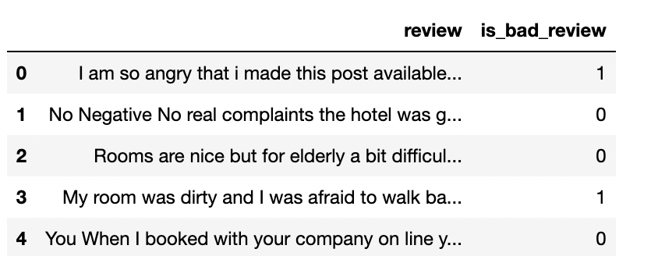
Collecting Data:
The initial step is to load the raw data. There is a positive and a negative section to each textual review. To begin with only raw text data and no other information, we group them together.
The data can be found here: https://www.kaggle.com/jiashenliu/515k-hotel-reviews-data-in-europe

Slide 5
Sentiment Analysis
Main Libraries used:
NLTK: Genism is the most well-known Python module for NLP techniques: a subject demonstrating and vector space displaying toolbox.
Scikit-learn: the Python machine learning library that is used the most We will use some hotel reviews data in this case.
For each printed survey, we need to foresee if it relates to a decent survey or to a terrible one. The overall ratings for the reviews can be anywhere from 2.5/10 to 10/10. To simplify the issue, we will divide those into two groups:
The challenge here is to be able to predict this information using only the raw textual data from the review. Good reviews have overall ratings greater than or equal to 5.

